Slide 1
Department of Computer Science
CS F364 – DESIGN AND ANALYSIS OF ALGORITHMS
LECTURE –Multithreaded and parallel Algorithms
PORTIONS: As specified in handout and the contents taught in class. Class notes is must. Refer to the textbook as mentioned in handout
PLEASE NOTE THAT PPT IS JUST AN ADDITIONAL REFERENCE.

Slide 2
Multithreading
Multithreading is the ability of a central processing unit (CPU) (or a single core in a multi-core processor) to provide multiple threads of execution concurrently, supported by the operating system.
In a multithreaded application, the threads share the resources of a single or multiple cores, which include the computing units, the CPU caches, and the translation lookaside buffer (TLB).

Slide 3
Multithreading
Multithreading is a crucial topic for modern computing. Parallel machines are getting cheaper and in fact are now ubiquitous ...
supercomputers: custom architectures and networks
computer clusters with dedicated networks (distributed memory)
multi-core integrated circuit chips (shared memory)
GPUs (graphics processing units) with multiple processors

Slide 4
Multithreading and Parallel Algorithms
Our emphasis here will be parallel algorithms, that is, multithreading a single algorithm so that some of its instructions may be executed simultaneously.
Parallelism can also be applied to scheduling and managing multiple algorithms, each running concurrently in their own thread and possibly sharing resources, as studied in courses on operating systems and concurrent and high performance computing.

Slide 5
Static and Dynamic Multithreading
Static threading provides the programmer with an abstraction of virtual processors that are managed explicitly. It's "static" because the programmer must specify in advance how many processors to use at each point. This can be difficult and inflexible with respect to evolving conditions.
Rather than managing threads explicitly, dynamic multithreading allows programmers specify opportunities for parallelism, and a concurrency platform manages the decisions of mapping these opportunities to actual static threads.
Web Browsers - A web browser can download any number of files and web pages (multiple tabs) at the same time and still lets you continue browsing. If a particular web page cannot be downloaded, that is not going to stop the web browser from downloading other web pages.
Web Servers - A threaded web server handles each request with a new thread. There is a thread pool and every time a new request comes in, it is assigned to a thread from the thread pool.

Slide 6
Basics of Dynamic Multithreading
We will use three keywords in our pseudocode, reflecting current parallel-computing practice:
parallel: add to loop construct such as for to indicate each iteration can be executed in parallel.
spawn: create a parallel subprocess, then keep executing the current process (parallel procedure call).
sync: wait here until all active parallel threads created by this instance of the program finish.
These keywords specify opportunities for parallelism without affecting whether (or not) the corresponding sequential program

Slide 7
Logical Parallelism
The parallel and spawn keywords do not force parallelism: they just says that it is permissible. This is logical parallelism.
A scheduler will make the decision concerning allocation to processors.
However, if parallelism is used, sync must be respected. For safety, there is an implicit sync at the end of every procedure.

Slide 8
Example: Parallel Fibonacci
Here is the definition of Fibonacci numbers:
F₀ = 0. F₁ = 1. F_{i} = F_{i-1} + F_{i-2}, for i ≥ 2.

Slide 9
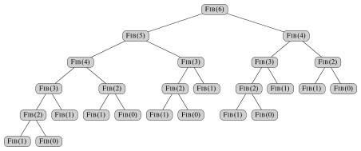
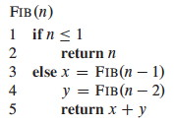


Recursive non-parallel algorithm for computing
Fib has recurrence relation T(n) = T(n − 1) + T(n − 2) + Θ(1), which has the solution T(n) = Θ(F_{n})
This grows exponentially in n, so it's not very efficient.
The analytical bound is given by

Slide 10
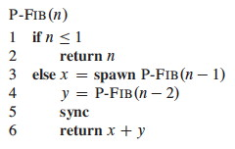
Fibonacci in Parallel: Two recursive calls in parallel using concurrency keywords
Notice that without the parallel keywords it is the same as the serial program above.

Slide 11
Fibonacci in Parallel:
A procedure cannot safely use the values returned by its spawned children until after it executes a sync statement, as in line 5.
The keyword sync indicates that the procedure must wait as necessary for all its spawned children to complete before proceeding to the statement after the sync.
In the P-FIB procedure, a sync is required before the return statement in line 6 to avoid the anomaly that would occur if x and y were summed before x was computed.
In addition to explicit synchronization provided by the sync statement, every procedure executes a sync implicitly before it returns, thus ensuring that all its children terminate before it does.

Slide 12
Modeling Dynamic Multithreading

Slide 13
A Model of Multithreaded Execution
We will model a multithreaded computation as a computation DAG (directed acyclic graph) G = (V, E):
Vertices in V represent instructions. To simplify the graph, each vertex can represent a strand: a sequence of non-parallel instructions, as they will all be treated the same as far as parallelism is concerned.
Edges in E represent dependencies between instructions or strands: (u, v) ∈ E means u must execute before v. (Edge are categorized in ways elaborated below.)
If G has a directed path from u to v they are logically in series; otherwise they are logically parallel.
A strand with multiple successors means all but one of them must have spawned. A strand with multiple predecessors means they join at a sync statement.
We assume an ideal parallel computer with sequentially consistent memory, meaning it behaves as if the instructions were executed sequentially in some full ordering consistent with orderings within each thread (i.e., consistent with the partial ordering of the computation DAG).

Slide 14
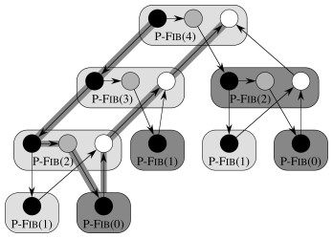
Visualizing the Model
Vertices (strands) are visualized as circles in the figure.
The rounded rectangles are not part of the formal model, but they help organize the visualization by collecting together all strands for a given call.
The colors are specific to this example and indicate the corresponding code: black indicates that the strand is for lines 1-3; grey for line 4; and white for lines 5-6.

